Slide 1
GROUP – 7 WORD FREQUENCY COUNTER
Ramya Bejawada
Varsha Narayana
Suvithra Murugan
Durga Bhavani Asadi

Slide 2
DAY 1 TO 5:
Day1: SRS Briefing.
Day2: Designing.
Day3: Coding.
Day4: CPPUnit , UT and IT.
Day5: GitHub and Presentation

Slide 3
DAY1:INTRODUCTION:
Word frequency counter is an application which counts number of times a word appears in multiple files.
Frequency of words are stored in Map.
Common words and invalid words are excluded from the frequency.
If user doesn't give any input file error will be displayed.
Common words are stored in commonwords.txt
Invalid words are stored in hash table.

Slide 4
Non Functional Requirements:
MultiFile MultiDirectory Solution:
1) SRC
2)OBJ
3)INCLUDE
4)COMPILE
5)BIN
6)TOOLS

Slide 5
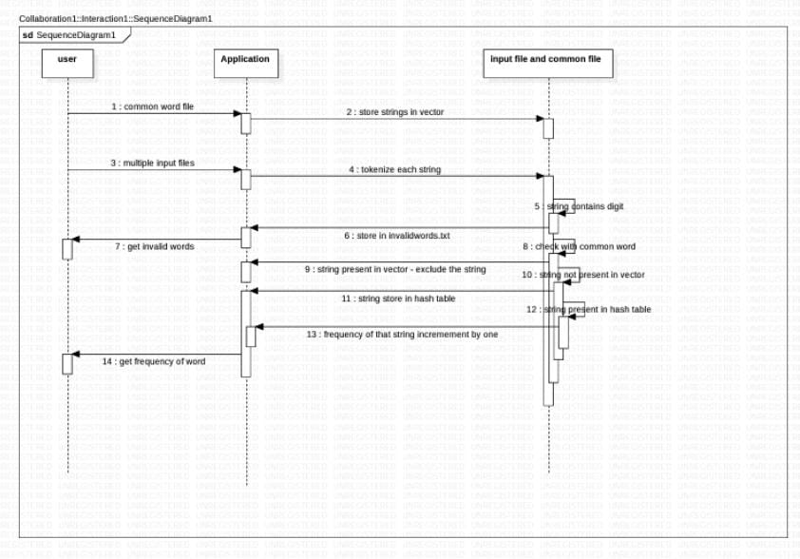
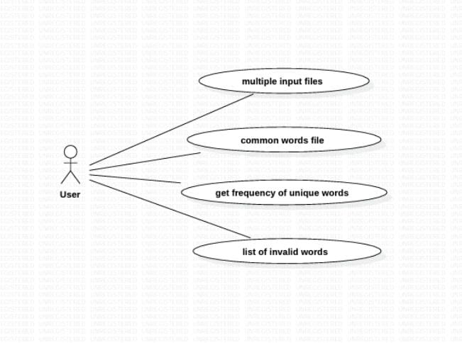
Day2:Designing:
USE-CASE DIAGRAM.
SEQUENCE DIAGRAM.

Slide 6
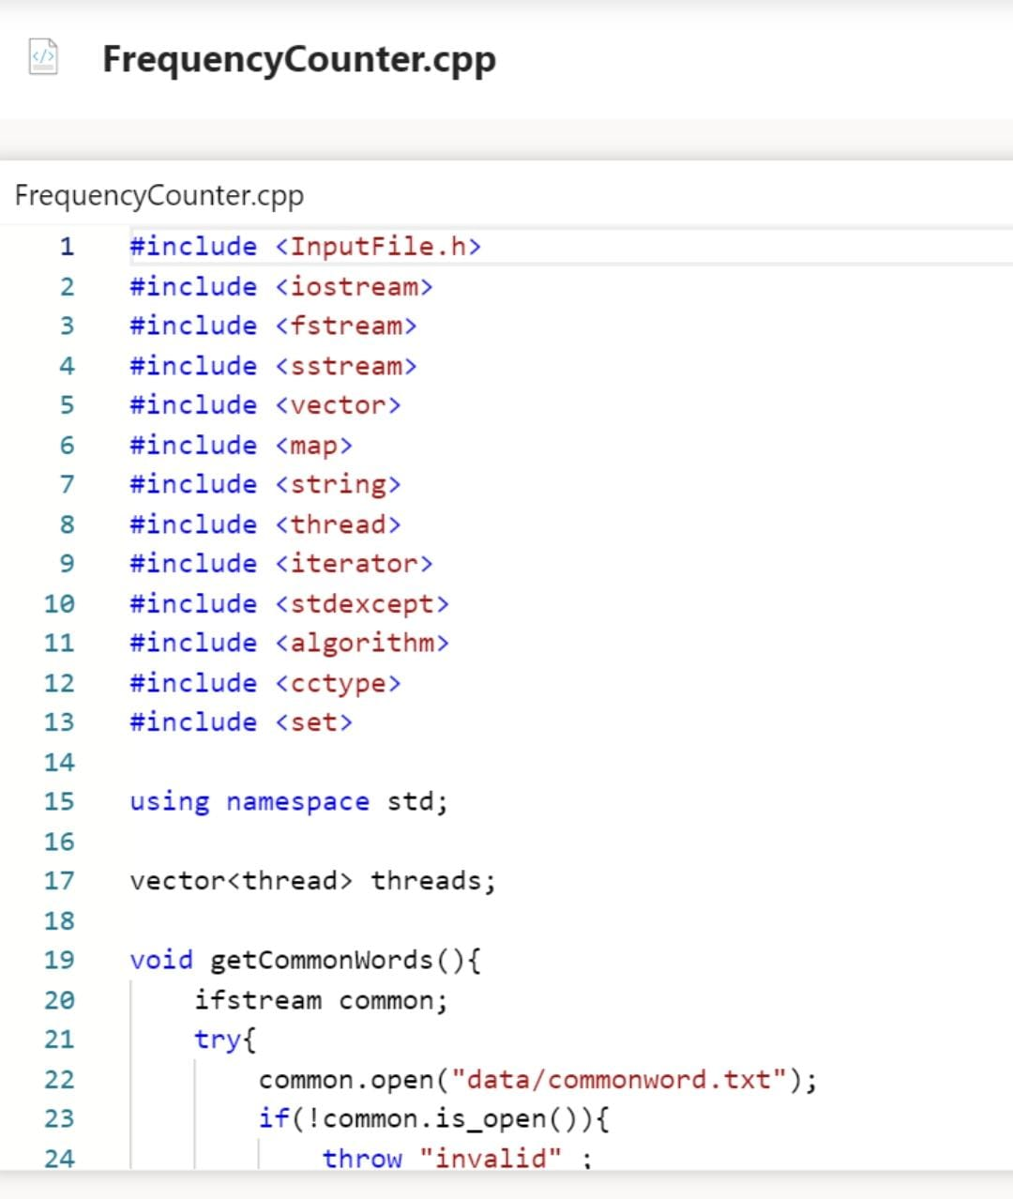
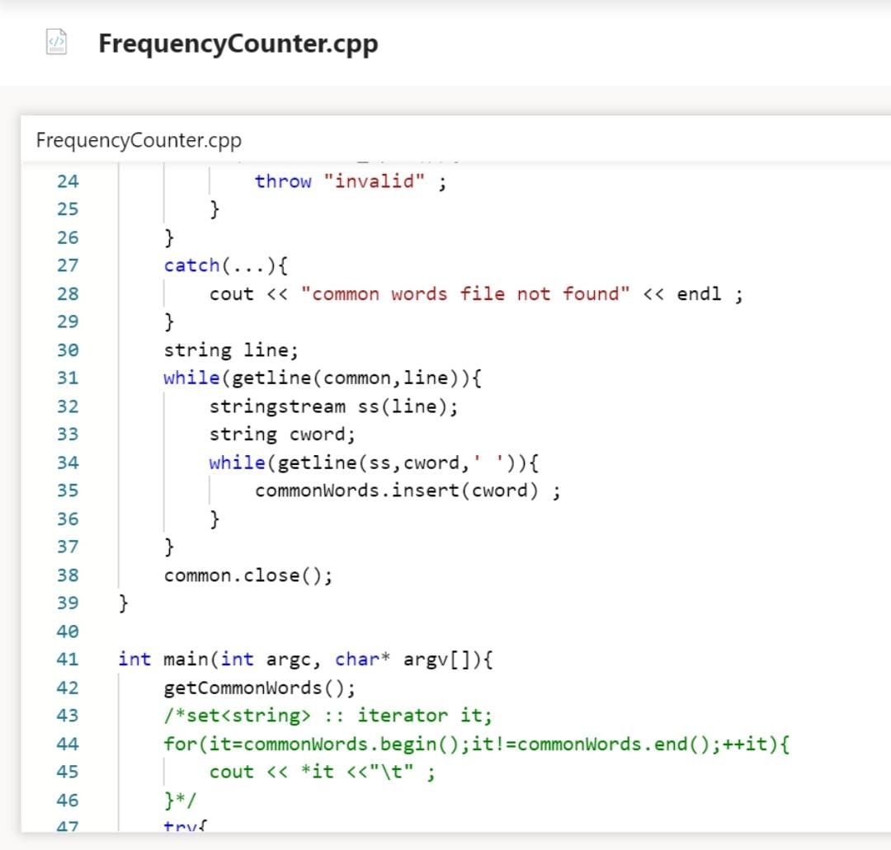

Slide 7
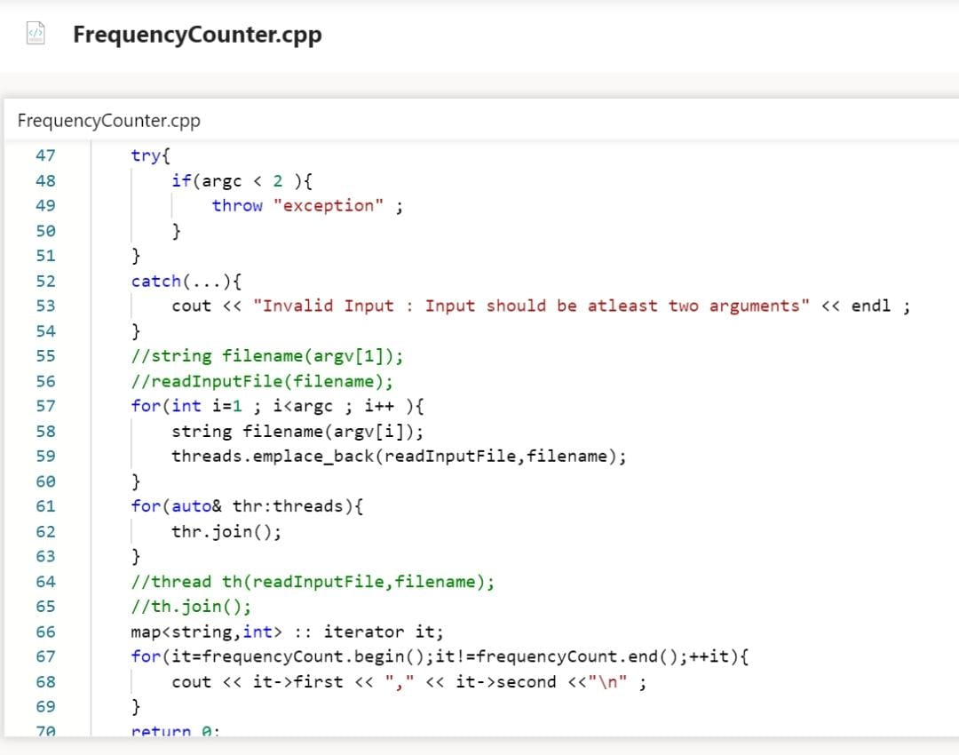
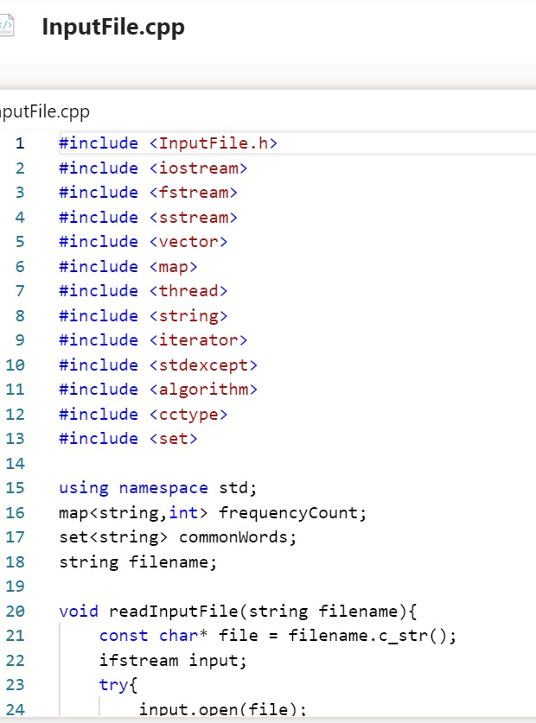

Slide 8
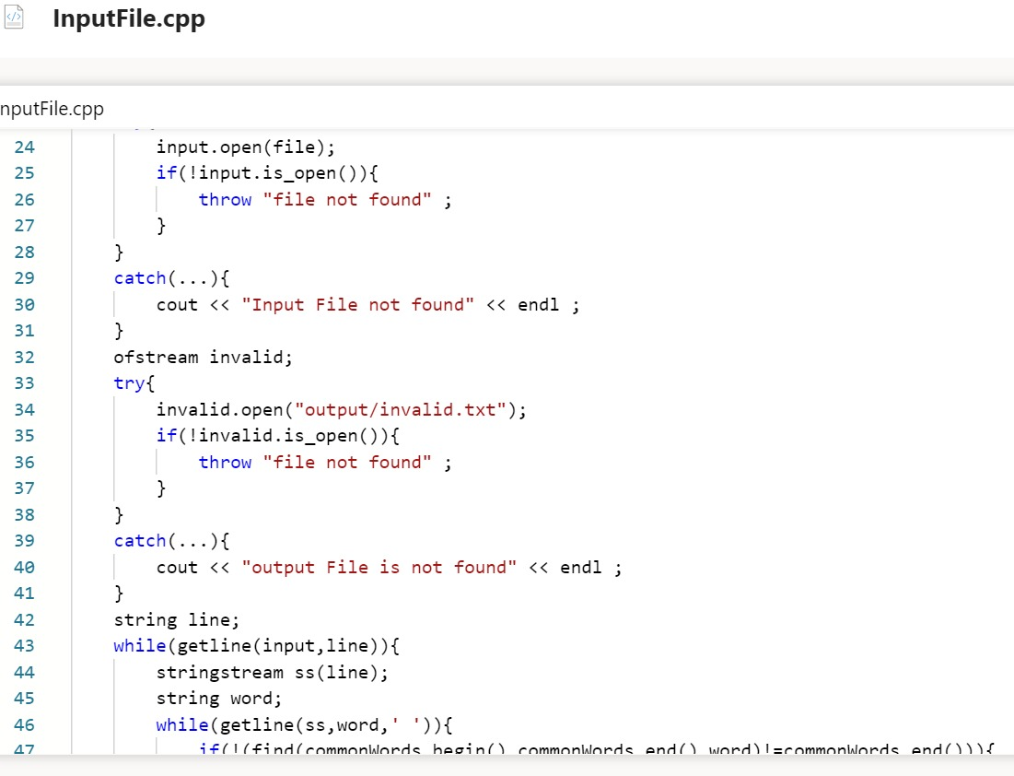
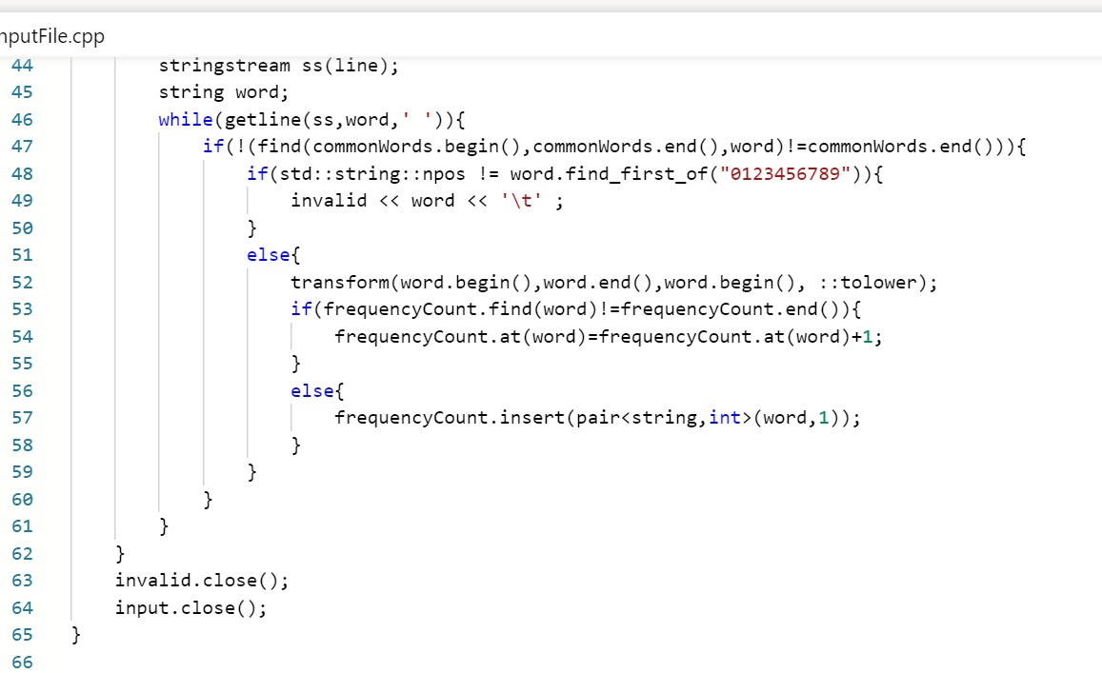

Slide 9
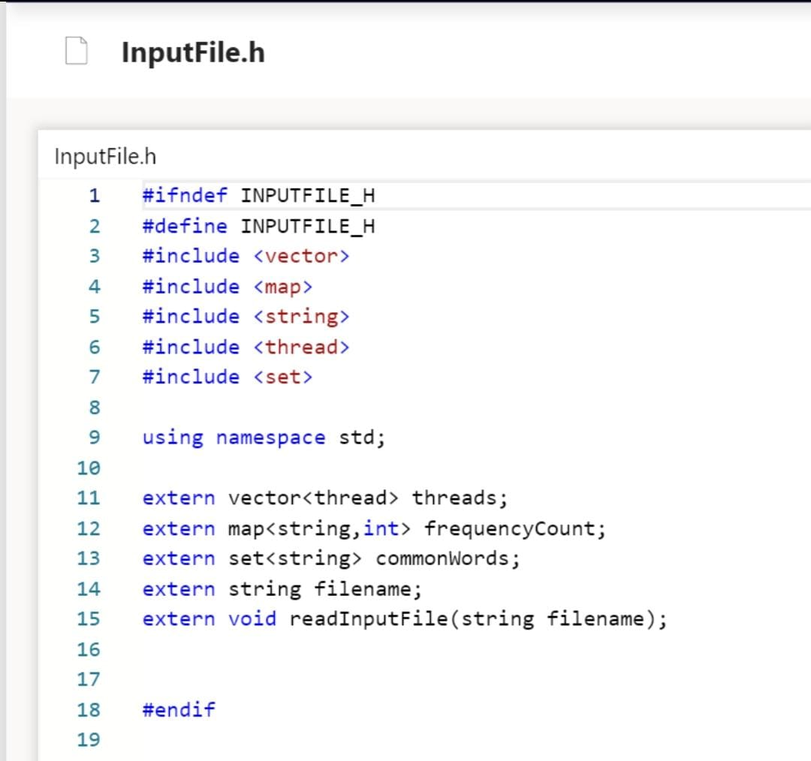

Slide 10
Day4:Testing Tools and Process:
1) Valgrind
2)CPP Unit

Slide 11
Conclusion:
Frequency of unique words are displayed
Common and Invalid words are removed from Inputfile.
We have implemented threads for giving multiple inputfiles at the time of execution.

Slide 12
THANK YOU

